Slide 1

Unit 8 - Lesson 2
Algorithm Efficiency

Slide 2
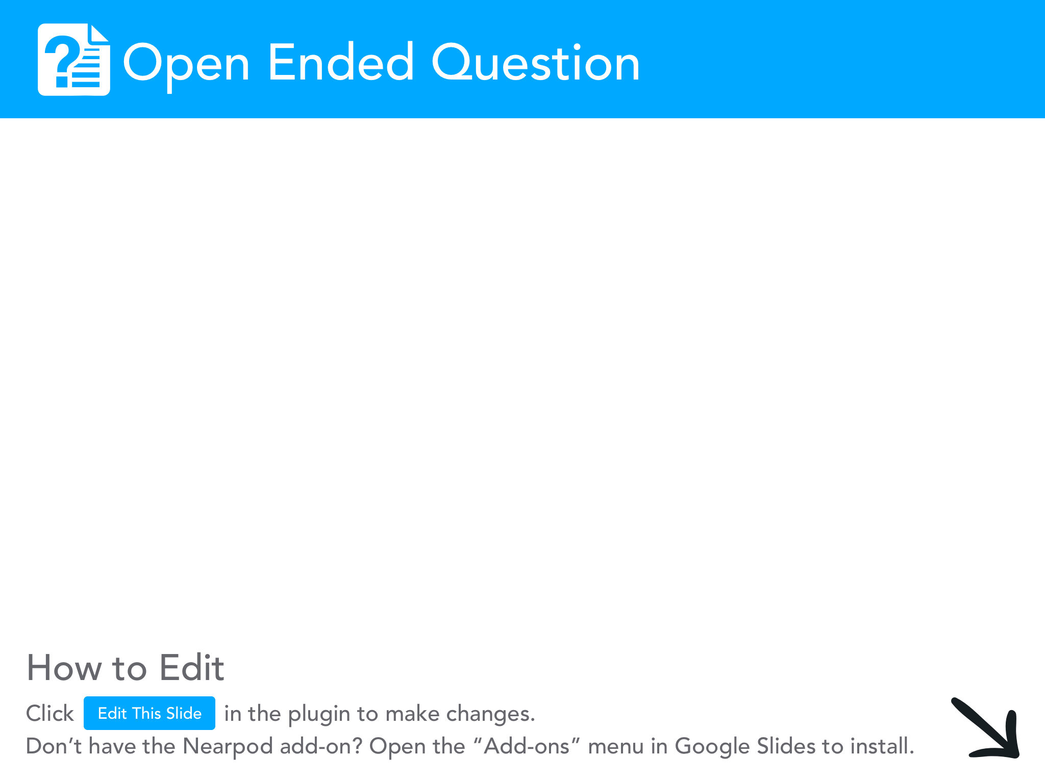
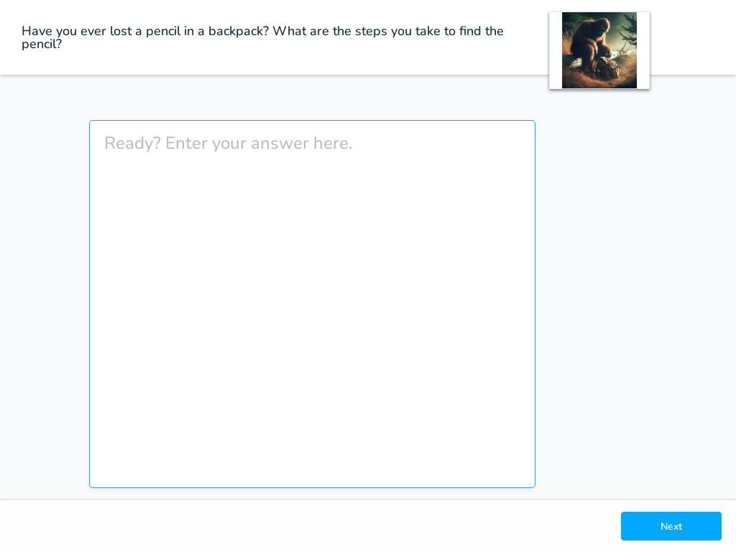

Slide 3

Unit 8 Lesson 2 - Activity
Everyone grab a whiteboard
and a dry erase marker.

Slide 4
Unit 8 Lesson 2 - Activity
I need 3 volunteers.

Slide 5
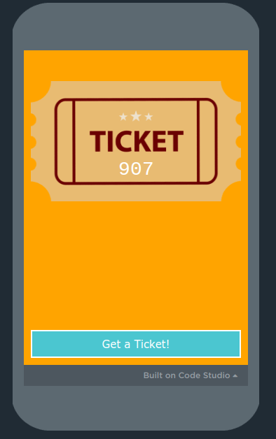
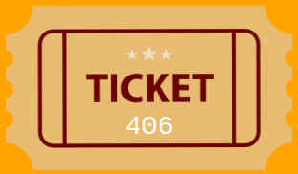
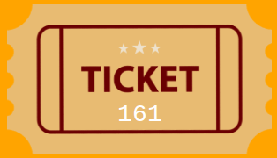
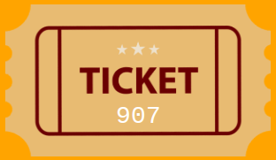
Unit 8 Lesson 2 - Activity
3 Volunteers:
We're going to have a raffle.
I'll pull up a QR Code - scan it with your phone to get your 'ticket'

Slide 6
Unit 8 Lesson 2 - Activity
Problem: Figure out if anyone has the winning raffle ticket
Instance: A list of tickets plus the winning number
Let's check if anyone has the winning number!

Slide 7
Unit 8 Lesson 2 - Activity
Prompt:
How many steps did it take to find out if anyone had the winning ticket?
(How many times did I have to ask someone their number?)
What is the greatest possible number of steps it could take for this?

Slide 8
Unit 8 Lesson 2 - Activity
Prompt:
What if we had six volunteers?
The whole class?
The whole school?
What is the pattern here?

Slide 9
Unit 8 Lesson 2 - Activity
 | inputs | steps
Instance | 3 | 3
Instance | 6 | 6
Instance | 10 | 10
Instance | 100 | 100
10 9 8 7 6 5 4 3 2 1
steps
1 2 3 4 5 6 7 8 9 10
inputs

Slide 10
Unit 8 Lesson 2 - Activity
With a partner…
Do This:
Use the ticket generator to generate seven tickets. Write down the numbers on your whiteboard in numerical order.
Copy one of the numbers to the top of your whiteboard. This is the number you are searching for.
Click
705
117
232
245
410
705
716
833

Slide 11
Unit 8 Lesson 2 - Activity
Challenge: With a partner Create an algorithm to determine if a given number is in a list of sorted numbers.
Pretend the numbers are hidden so you cannot see them unless you unhide them one at a time when comparing them. That is, you can only "see" one of the numbers in your list at a time.
The search can start at any of the numbers, but you can only compare one at a time. All other numbers are flipped over so you cannot see them.
You can "jump" over numbers. In other words, you don't need to search them in order.
You can determine which number to search next based on the current number you are checking.
The goal is to make the determination in the least steps possible, but don't forget your number could be anywhere in the list - what is the worst possible case? What is the greatest number of comparison steps it would take to find any number in your list using your current algorithm?

Slide 12
Unit 8 Lesson 2 - Activity
Share & Compare: Partner up with another group. Share your algorithms and practice running both fully. Determine which one is "faster" or takes the least amount of comparison steps.

Slide 13
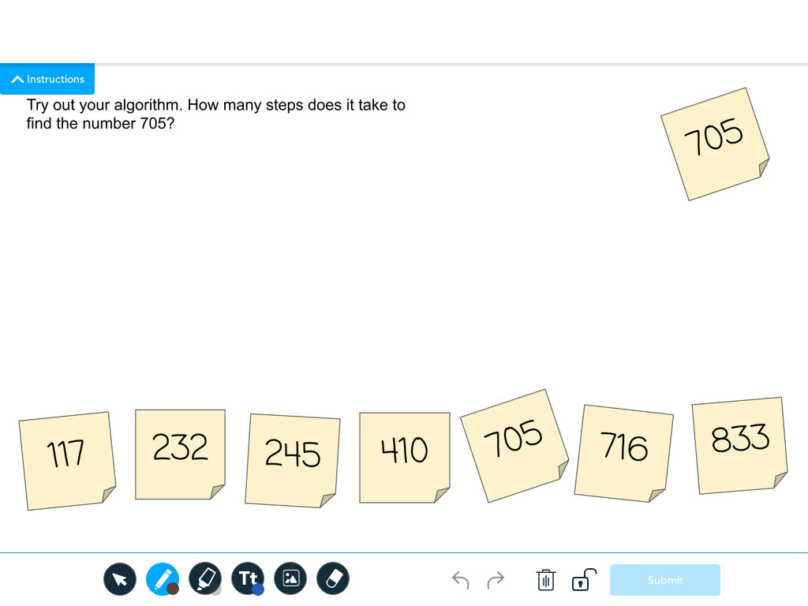
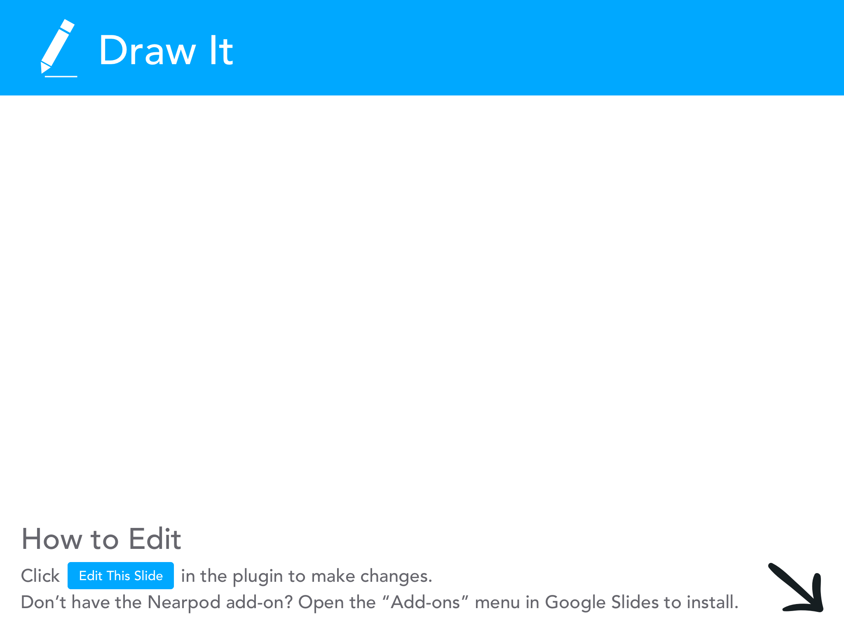

Slide 14
Unit 8 Lesson 2 - Activity
Do This: Now try this algorithm. See how it compares to your own.
Find the middle number in the list. Compare that number to the given number. If the number is less than the given number, remove all of the cards to the right (including the middle number). If the number is more than the given number, remove all of the cards to the left (including the middle number).
Find the middle number in this shorter list. Follow the instructions in Step #1 for comparing.
Find the middle number in this new shorter list. Follow the instructions in Step #1 for comparing.
You have found your number!

Slide 15
Unit 8 Lesson 2 - Activity
Do This: Let's try out the algorithm with another raffle!
Everybody scan the qr code to get your number.
Line up across the front of the room IN NUMERICAL ORDER.
Smaller
#s
Larger
#s

Slide 16
Unit 8 Lesson 2 - Activity
🔍
705
Binary Search:
232
705
716
833
117
245
410

Slide 17
Unit 8 Lesson 2 - Activity
🔍
Binary Search:
705
compare
232
705
716
833
117
245
410
STEP 1

Slide 18
Unit 8 Lesson 2 - Activity
🔍
Binary Search:
705
compare
GREATER THAN
232
705
716
833
117
245
410
STEP 1

Slide 19
Unit 8 Lesson 2 - Activity
🔍
Binary Search:
232
705
716
833
117
245
410
STEP 1

Slide 20
Unit 8 Lesson 2 - Activity
🔍
Binary Search:
705
compare
232
705
716
833
117
245
410
STEP 1
STEP 2

Slide 21
Unit 8 Lesson 2 - Activity
🔍
Binary Search:
705
compare
LESS
THAN
232
705
716
833
117
245
410
STEP 1
STEP 2

Slide 22
Unit 8 Lesson 2 - Activity
🔍
Binary Search:
232
705
716
833
117
245
410
STEP 1
STEP 2

Slide 23
Unit 8 Lesson 2 - Activity
🔍
Binary Search:
705
compare
232
705
716
833
117
245
410
STEP 1
STEP 3
STEP 2

Slide 24
Unit 8 Lesson 2 - Activity
🔍
Binary Search:
705
compare
EQUAL TO!
232
705
716
833
117
245
410
STEP 1
STEP 3
STEP 2

Slide 25
Unit 8 Lesson 2 - Activity
🔍
Binary Search:
We found the number! 705 is in the list.
705
compare
EQUAL TO!
232
705
716
833
117
245
410
STEP 1
STEP 3
STEP 2

Slide 26
Unit 8 Lesson 2 - Activity
Do This: Now try the Binary Search algorithm for different instances. We've done a few for you! Copy this table and keep track of the number of steps it takes on your whiteboard.
 | inputs | steps
Instance | 1
Instance | 3
Instance | 5
Instance | 7 | 3
Instance | 9
Instance | 15 | 4
15
14
13
12
11
10 9 8 7 6 5 4 3 2 1
steps
1 2 3 4 5 6 7 8 9 10 11 12 13 14 15
inputs

Slide 27
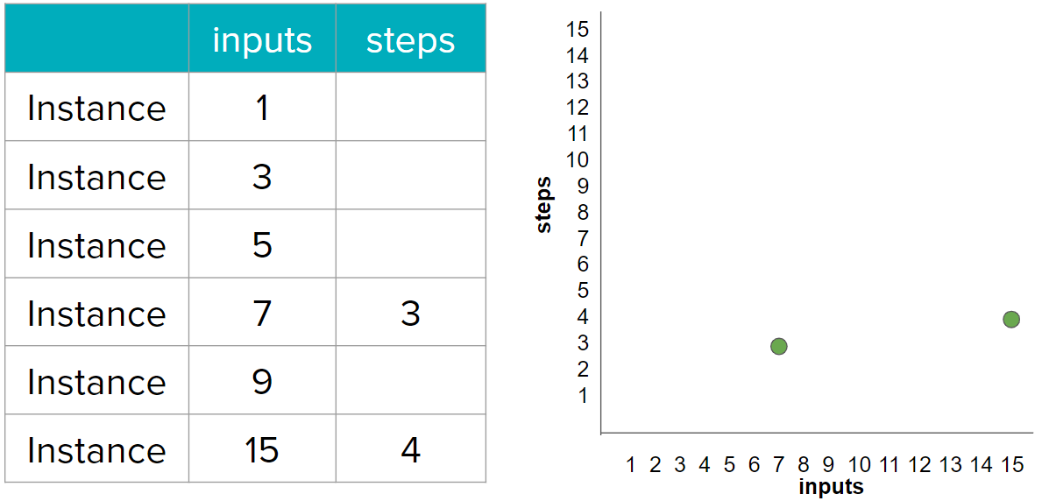
Unit 8 Lesson 2 - Activity
Do This: Now try this algorithm. See how it compares to your own.
Find the middle number in the list. Compare that number to the given number. If the number is less than the given number, remove all of the cards to the right (including the middle number). If the number is more than the given number, remove all of the cards to the left (including the middle number).
Find the middle number in this shorter list. Follow the instructions in Step #1 for comparing.
Find the middle number in this new shorter list. Follow the instructions in Step #1 for comparing.
You have found your number!

Slide 28
Unit 8 Lesson 2 - Activity
Let's see what the most steps it took in the class to find the numbers.
 | inputs | steps
Instance | 1
Instance | 3
Instance | 5
Instance | 7 | 3
Instance | 9
Instance | 15 | 4
15
14
13
12
11
10 9 8 7 6 5 4 3 2 1
steps
1 2 3 4 5 6 7 8 9 10 11 12 13 14 15
inputs

Slide 29
Unit 8 Lesson 2 - Activity
 | inputs | steps
Instance | 1
Instance | 3
Instance | 5
Instance | 7 | 3
Instance | 9
Instance | 15 | 4
15
14
13
12
11
10 9 8 7 6 5 4 3 2 1
1
steps
1 2 3 4 5 6 7 8 9 10 11 12 13 14 15
inputs

Slide 30
Unit 8 Lesson 2 - Activity
 | inputs | steps
Instance | 1
Instance | 3
Instance | 5
Instance | 7 | 3
Instance | 9
Instance | 15 | 4
15
14
13
12
11
10 9 8 7 6 5 4 3 2 1
1
2
steps
1 2 3 4 5 6 7 8 9 10 11 12 13 14 15
inputs

Slide 31
Unit 8 Lesson 2 - Activity
 | inputs | steps
Instance | 1
Instance | 3
Instance | 5
Instance | 7 | 3
Instance | 9
Instance | 15 | 4
15
14
13
12
11
10 9 8 7 6 5 4 3 2 1
1
2
steps
3
1 2 3 4 5 6 7 8 9 10 11 12 13 14 15
inputs

Slide 32
Unit 8 Lesson 2 - Activity
 | inputs | steps
Instance | 1
Instance | 3
Instance | 5
Instance | 7 | 3
Instance | 9
Instance | 15 | 4
15
14
13
12
11
10 9 8 7 6 5 4 3 2 1
1
2
steps
3
4
1 2 3 4 5 6 7 8 9 10 11 12 13 14 15
inputs

Slide 33
Unit 8 Lesson 2 - Activity
 | inputs | steps
Instance | 1
Instance | 3
Instance | 5
Instance | 7 | 3
Instance | 9
Instance | 15 | 4
15
14
13
12
11
10 9 8 7 6 5 4 3 2 1
1
2
steps
3
4
1 2 3 4 5 6 7 8 9 10 11 12 13 14 15
inputs

Slide 34
Unit 8 Lesson 2 - Activity
There's another way of thinking about this. Can you see the pattern?
 | inputs | steps
Instance | 1
Instance | 3
Instance | 5
Instance | 7 | 3
Instance | 9
Instance | 15 | 4
How many bits does it take to represent 1 in Binary?
1
2
3
4

Slide 35
Unit 8 Lesson 2 - Activity
There's another way of thinking about this. Can you see the pattern?
 | inputs | steps
Instance | 1
Instance | 3
Instance | 5
Instance | 7 | 3
Instance | 9
Instance | 15 | 4
How many bits does it take to represent 1 in Binary?
1
1
2
3
4

Slide 36
Unit 8 Lesson 2 - Activity
There's another way of thinking about this. Can you see the pattern?
 | inputs | steps
Instance | 1
Instance | 3
Instance | 5
Instance | 7 | 3
Instance | 9
Instance | 15 | 4
How many bits does it take to represent 1 in Binary?
1
1
2
What about 7?
3
4

Slide 37
Unit 8 Lesson 2 - Activity
There's another way of thinking about this. Can you see the pattern?
 | inputs | steps
Instance | 1
Instance | 3
Instance | 5
Instance | 7 | 3
Instance | 9
Instance | 15 | 4
How many bits does it take to represent 1 in Binary?
1
1
2
What about 7?
3
1
1
1
4 + 2 + 1
4

Slide 38
Unit 8 Lesson 2 - Activity
There's another way of thinking about this. Can you see the pattern?
 | inputs | steps
Instance | 1
Instance | 3
Instance | 5
Instance | 7 | 3
Instance | 9
Instance | 15 | 4
How many bits does it take to represent 1 in Binary?
1
1
2
What about 7?
3
1
1
1
And 15?
4
8 + 4 + 2 + 1
1
1
1
1

Slide 39
Unit 8 Lesson 2 - Activity
Here's our two search algorithms we've explored. The first is linear. As we add more inputs, the number of steps grows at the same rate.
15
14
13
12
11
10 9 8 7 6 5 4 3 2 1
The second represents what happens with Binary Search. Notice how it grows at a much slower rate! Binary Search is faster than Linear search, BUT the data must be sorted.
LINEAR
Binary Search
1 2 3 4 5 6 7 8 9 10 11 12 13 14 15

Slide 40
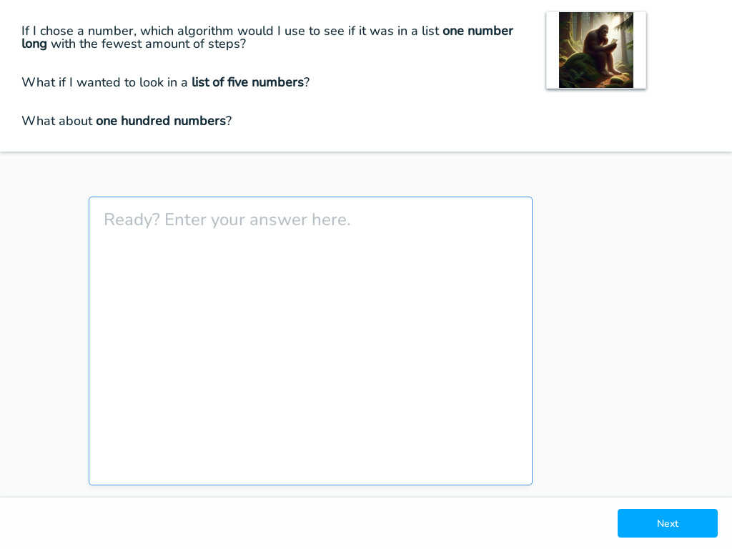

Slide 41

Unit 8 Lesson 2 - Wrap Up
Efficiency: a measure of how many steps are needed to complete an algorithm
Linear Search: a search algorithm which checks each element of a list, in order, until the desired value is found or all elements in the list have been checked.
Binary Search: a search algorithm that starts at the middle of a sorted set of numbers and removes half of the data; this process repeats until the desired value is found or all elements have been eliminated.
15
14
13
12
11
10 9 8 7 6 5 4 3 2 1
LINEAR
Binary Search
1 2 3 4 5 6 7 8 9 10 11 12 13 14 15

Slide 42
